Slide 1
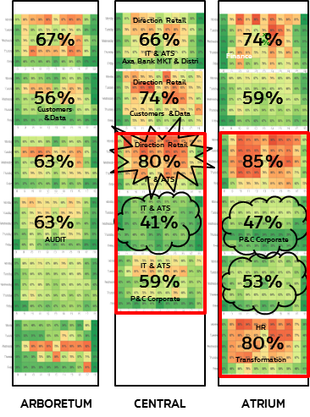
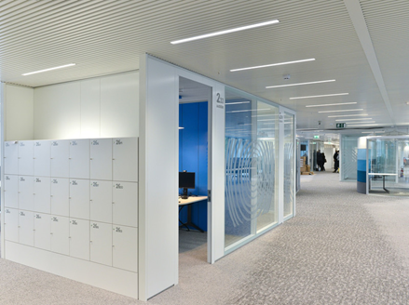
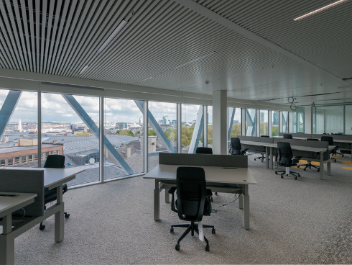
Customer story Building management
NWOW
AXA
Need: Reduce costs and space; 6 desks for 10 employees
Solution: Floor occupancy solution + LoRa sensors & network + analytics
Result: real-time management and cost reduction

